Slide 1
Unit 1 Lesson 1
3
Long Vowels

Slide 2
a_e ame ake ate ave
A
Listen and learn.
tape
a_e
This is tape.
What’s the middle sound?

Slide 3
a_e ame ake ate ave
B
Listen, point, and read.
1.
tape

Slide 4
a_e ame ake ate ave
B
Listen, point, and read.
2.
cape

Slide 5
a_e ame ake ate ave
B
Listen, point, and read.
3.
cane

Slide 6
a_e ame ake ate ave
B
Listen, point, and read.
4.
mane

Slide 7
a_e ame ake ate ave
C
Listen, point, and read.
1.
tap
tape

Slide 8
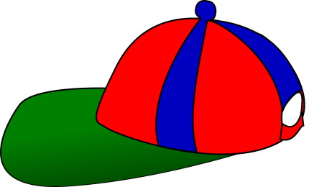
a_e ame ake ate ave
C
Listen, point, and read.
2.
cap
cape

Slide 9
a_e ame ake ate ave
C
Listen, point, and read.
3.
can
cane

Slide 10
a_e ame ake ate ave
C
Listen, point, and read.
4.
man
mane

Slide 11
a_e ame ake ate ave
D
Listen, read, and circle.
1.
can
cane

Slide 12
a_e ame ake ate ave
D
Listen, read, and circle.
2.
cape
cap

Slide 13
a_e ame ake ate ave
D
Listen, read, and circle.
3.
mane
man

Slide 14
a_e ame ake ate ave
D
Listen, read, and circle.
4.
tap
tape

Slide 15
a_e ame ake ate ave
E
Listen and chant. Then read.
Point to the correct words when you chant.
The man has tape and a cane.

Slide 16
a_e ame ake ate ave
A
Listen and learn.
game
a _ e
This is a game.
What’s the middle sound?

Slide 17
a_e ame ake ate ave
A
Listen and learn.
cake
a_e
This is a cake.
What’s the middle sound?

Slide 18
a_e ame ake ate ave
B
Listen, point, and read.
1.
game

Slide 19
a_e ame ake ate ave
B
Listen, point, and read.
2.
cake

Slide 20
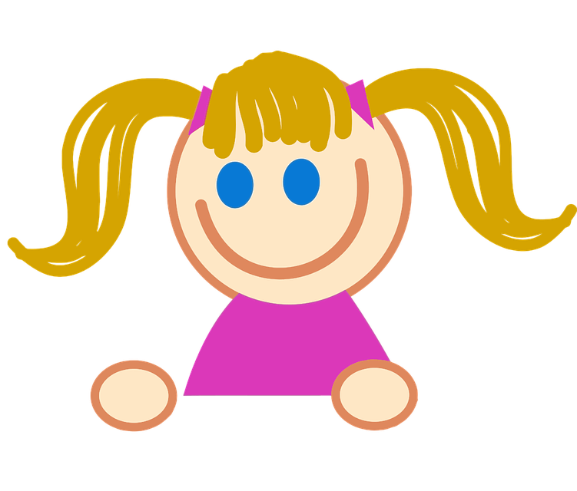
a_e ame ake ate ave
B
Listen, point, and read.
3.
Sunny
name

Slide 21
a_e ame ake ate ave
B
Listen, point, and read.
4.
lake

Slide 22
a_e ame ake ate ave
C
Listen and number.
Sunny
3
1
4
6
5
2

Slide 23
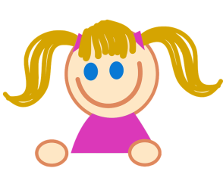
a_e ame ake ate ave
D
Listen and write. Then match the words that rhyme.
1.
2.
lake
name
Sunny
3.
4.
game
cake

Slide 24
a_e ame ake ate ave
E
Listen and chant. Then read.
Point to the correct words when you chant.
name cake game lake

Slide 25
a_e ame ake ate ave
3
Long Vowels
End of Unit 1 Lesson 1

